Slide 1
The European Knowledge Tree Group (EKTG) with AAL
Supporting integrated care in Estonia
Rait Kuuse
Ministry of Social Affairs, Estonia
Email : rait.kuuse@sm.ee
Workshop 1 24th September, 2019, AAL Forum, Aarhus, Denmark

Slide 2
Supporting integrated care in Estonia
Main goal: To contribute to the development of a more integrated and person-centred provision of social, medical and vocational support services to people with disabilities and elderly with high support needs.
Together with International Foundation of Integrated Care (IFIC) and with the support of EC SRSS
Four parallel workstreams throughout the project
Developing a High-Level Strategy Towards Integrated Care Provision
Models of Care: selected pathways (focus on coordination model)
Review of Information Systems and Databases and developing a concept for integrated policy dataset
Financing and incentive models (focus on coordination model)
Life-cycle approach used!
Notes:
Taustaslaid
There is general agreement across different stakeholders that better integration is needed, the question is how to best achieve it
With the support of EC SRSS and International Foundation of Integrated Care (IFIC), taking lessons learnt from different pilots and initiatives and creating an integration strategy and „back-office“ support to scale good solutions, measure the impact and plan future changes

Slide 3

Background. System view
How are individuals actually supported?
By whom?
With what results?
Is there duplication of services?
Is local level support provided before moving to complex state services?
Where to direct additional resources to get best results?
…
Notes:
Taustaslaid
We don’t often have enough data to plan policies
We do know that around 16 000 people receive social rehabilitation last year, around 5500 people special care services, around 2200 people work-related rehabilitation, around, almost 8000 people general care service and around 6400 people domestic service. What we usually do not know is whether some of these services are provided to same individuals, how much community-based support people get before being institutionalised and what are the results that are being achieved in combination of these support mechanisms.
We often have bits and pieces but not the big pictures. Too often we operate on guesses and not actual full data. We need to take advantage of big data. Also, look at diferent systems (healthcare and welfare, in some parts education and employment) in one ‘picture’. Need to understand what is needed to design good policies, what is needed to support the individual. Care models, data, financing and incentives.

Slide 4
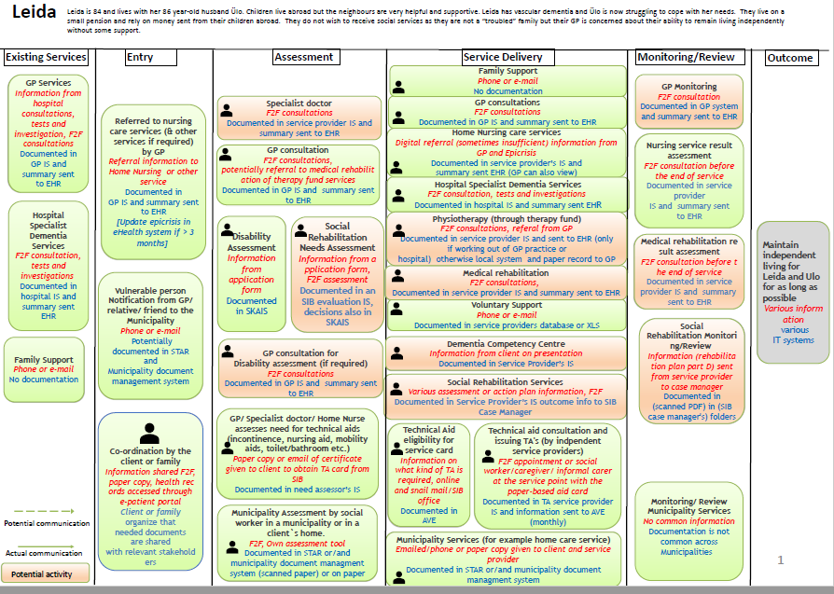

Slide 5
Taking advantage of data to support integrated care
Two types of data:
Aggregate data to support policy making
Case level data to support care pathways and service delivery on the individual level
Two timelines
Short-term: things that can be done with data (more or less) right now, without major new developments
Medium-term: things that can be done based on improved approaches to data collection and integration

Slide 6
Policy dataset. Main principles
Measures derived from secondary data where possible
Minimise the number of measurements
Aim for operational and scalable dataset showing variation over time (not one-off research datasets)
Where there are gaps in data – link new primary sources of data capture to service delivery
Try to get a balance (across the quadruple aim)
Look at measures that are at the intersection points of care provision (not necessarily at the specific service)

Slide 7
Policy dataset – where are we at?
Preparing a test dataset (based on one municipality) where information linked together and pseudonymised before analysis
Mainly automatic pull from databases, but some municipality-level data manually collected
Proof of concept analysis to understand what kind of questions could be answered with such data
Goal for future: different dashboards for different stakeholders to do policy analysis, measure the impact of integrated policies etc.

Slide 8
Case level data – where are we at?
Case level data to support care pathways and service delivery on the individual level
Mapping the access barriers and creating an understanding which information needs to be opened and to whom to allow better integration;
Main question to be solved – will the basis be consent of individual or general legal basis

Slide 9
Thank you!

