Slide 1
The European Knowledge Tree Group (EKTG) with AAL
The Value of the Silver Economy using the Gold of the Future
Maggie Ellis
EKTG Coordinator
m.ellis1.lse.ac.uk@icloud.com

Slide 2
The Tallinn Declaration 2017 Stressed the need for better Digital Services Promises a digital future for Europeans All member states, agreed on common goals for eGovernment development over the next five years. Smart Cities and communities will develop
Workshop 1 24th September, 2019, AAL Forum, Aarhus, Denmark

Slide 3
Benefits & Challenges of Data
Example benefits:
Reducing readmissions
More efficiency & effectiveness
Better quality of life
Better health products and services
Challenges (from EIT Health Big Data Strategy planning)
data quality
diversity
data protection
interoperability
and
tendency to lock up rather than share data
uncertainty to give access to data
rapid rise of user generated real world data
pervasive interest in Europe-wide solutions but lack of plan and leadership
Workshop 1 24th September, 2019, AAL Forum, Aarhus, Denmark

Slide 4
Analytic options can be categorised at a high level into three distinct types. No one type of analytic is better than another, they co-exist and complement each other.
Descriptive Analytics, which use data aggregation and data mining to provide insight into the past and answer: “What has happened?”
Predictive Analytics, which use statistical models and forecasts techniques to understand the future and answer: “What could happen?”
Prescriptive Analytics, which use optimisation and simulation algorithms to advice on possible outcomes and answer: “What should we do now?”
So we want to help you to decide how to handle Data so it is practical for You, Your Staff, and your Users!
Some people have encouraged User independence to create cost effective services
As funding is frequently limited this is essential in good practice.
Workshop 1 24th September, 2019, AAL Forum, Aarhus, Denmark

Slide 5
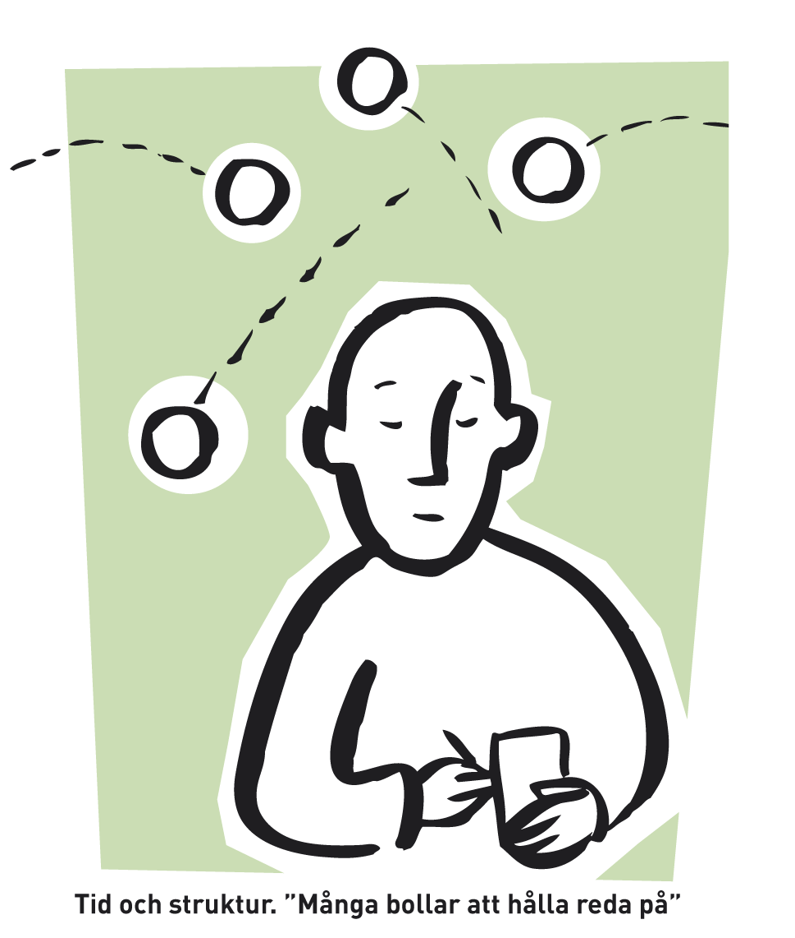
Cost-benefit assessment – Mental health service example in Sweden
Benefit in a year per user:
Reduced use of formal carers: 1 hr /week Saving: SEK 15,600
Reduced need of informal carers: 1 hr /week Saving: SEK 4,000
Increased employment and production Saving: SEK 13,200
Total Saving: SEK 32,800
Workshop 1 24th September, 2019, AAL Forum, Aarhus, Denmark
Notes:
Ej vård kostnader inräkning

Slide 6
Management of health and care data access and control is crucial
Fundamental principle: Health data belongs to the data subject
Access to my data
Control of my data
Delegation of my access and control rights
Legal framework functions in combination with appropriate technology and governance
Workshop 1 24th September, 2019, AAL Forum, Aarhus, Denmark

