Slide 1
Our Contribution
From Prophet to Profit….will the digital revolution ever be profitable?
An event organised jointly by EKTG and Fairhome at Salford Quays
November 26th, 2019
M.Ellis1@lse.ac.uk

Slide 2
Our Contribution
About Us
The prefect Storm
General Provider Challenges
Provider benefits
Why is Technology important?
Benefits and Impacts
Five easiest things to use for impact
My recommendations

Slide 3
About Us
85 Specialist services across England and Wales
Supporting circa 1,098 people in accommodation, and a further 200 in the community
Services cover Supported Living, Residential and Community Care
Service support people with a Learning Disability, Physical Disability, Complex Care, Mental Health, Elderly and Outreach Services
Much of the business is clustered into key populated areas, with significant presence in
- North East
Liverpool/Chester
Yorkshire
East Midlands
Essex
Dorset
Devon
Business also works with The Valorum Foundation, which is the charitable arm of the organisation, which supports the volunteer programme and the skills centres

Slide 4
UK wide platform – delivering multiple services
Residential Care
Nursing Care
Supported Living
Community Services
Skills Centre
18 Services
11 Services
55 Services
3 Services
1 Service
324 Beds
321 Beds
425 Beds
28 Beds
0 Beds

Slide 5
The perfect storm………
Fantastic Opportunity
Rising demand - the number of people aged over 85 is projected to more than double between 2010 and 2035
High growth in recent years in supported living (CAGR of 7.8%) and looking forward, growth prospects remain positive for supported living
Specialised supported housing for people with learning disabilities is predicted to increase by 36% as the population grows and more people are moved out of hospital settings
But………….
The number of nursing and residential care home beds available is reducing by 1,000 a year, year on year, placing additional demand on current services
Reduced funding - 17% real drop in social spending on the elderly since 2009/10.
Rising costs – annual increase in National Minimum Wage for adults and 17% for apprentices in 2015
Increased pension costs year on year
Embracing technology isn’t always seen as a priority for providers

Slide 6
Spot the difference!
Minimum Wage Increase since 2010
Social Care funding

Slide 7
Perceived Barriers

Slide 8
General Provider Challenges
One of the biggest problems facing adult social care providers is managing the complex network of stakeholders, clients, staff and suppliers, all while maintaining a high quality of service and care.
Too many options for technology solutions
Too many different systems
Path is littered with failed technology projects
Technology dates so quickly
Incentives for care providers – potentially lose money by investing in technology – limited capital funding
Incentives for care providers – implementing technology reduces the need for care, but also reduces the need for care and support and therefore reduces revenue and profits
Lack of aligned working between providers
Lack of aligned working between Local Authorities and NHS and Private providers
Historically predominantly “mature” workforce – technophobes

Slide 9
As a provider what worries me………
Lack of awareness of what is available and possible
What systems should we use?
Does one size fit all?
If it doesn’t do, I have the platforms to support multiple options?
How do I know they will work – we have seen so many historic projects work?
Cohesion
We work with 140 councils – they all have different strategies and platforms; it feels like a bit of a nightmare to engage with all these stakeholders
Cost
Can I afford it?
Capital cost is a worry – who pays for this investment
Ongoing subscriptions – will I be tied into something that will be obsolete soon?

Slide 10
As a provider what worries me………
Short-term disruption for staff training
Will the staff embrace technology
How do I encourage staff to undertake this training
Fear about confidentiality
How safe are systems
GDPR is a key area
Concerns about using and relying on technology by relatives, care professionals and regulatory bodies.
Some people we support, relatives etc will embrace and some wont
What happens when the wifi doesn’t work!

Slide 11
Some Facts around Care and Support Workers and Technology
50% of staff use technology with the people they support
46% have a tablet device at home , compared with 8% having a work tablet
74% of staff have a personal mobile
20% of staff use their personal mobile for work
Staff have confidence in their own basic online skills with over 90% feeling confident or very confident. But 52% of managers feel staff do not have enough basic online skills
Staff are keen to use digital technology 60% of managers encourage staff to think about digital technology in all they do
Almost 80% care organisations still use paper records

Slide 12
Case Study
Care Workers – remote working
Visiting people in their own homes
People with complex needs
Some people lived in remote areas, or challenging urban areas
Provided mobile phones
Bespoke app to record tasks
App recorded locations

Slide 13
Outcome
Big Brother is watching me
You are only doing this, so I get paid less money
You know you trained me on the app but I don’t know how to use it, but don’t worry I did all I was asked to do
I don’t like the phone, its different from the one I am used to
I don’t like carrying two phones around with me, I feel like a drug dealer
The battery keeps running out, and my car charger doesn’t work

Slide 14
Summary
Provider confidence in care staff
Provider confidence in complicated solutions
Care staff confident that tech is been used for the right reasons
Care staff having the skills to use the technology
But are we overcomplicating this????????

Slide 15
But we must remember why technology is so important
Technology for the people we support, is it not particularly different from the technology any of us use?
Technology that we all use can enhance the life of a person living in supported living, or in a care setting more than it can you or it, for us it can be a gimmick, for people requiring care or support it can be a lifeline
Very crucially -
We need to embrace - “Creating technology that aids people to live in their own homes or in a care setting is not just an exercise in cutting healthcare costs, but helping people feel happier and safer.
Not only can healthy smart homes monitor for emergency events, they can help in the management of long-term conditions, and even feedback to occupants information to help them live more healthy lives.”

Slide 16
Technology Impacts for the People we Support
Technology can:
Give people more control over their health, safety and wellbeing
Support them to be more independent or feel less isolated
Link them to services which are important for them
Enhance the care or treatment providers offer
Help them communicate with families, professionals and staff
Help staff to prioritise and focus their attention on people who need it most
Capture and compare data and share good practice with peers.

Slide 17
Technology Impacts for Providers, Stakeholders and Families
Impact for professionals:
Sustainability of provision and management of costs
Focused and targeted approach for people whose needs may not be best supported by technology
Satisfaction of helping service users get the best care and maintain their independence in a more wide-ranging way
Impact for the council:
Beyond cost savings, the council will be at the forefront of innovation, introducing technology delivering a more personalised and cost-efficient care for people with learning disabilities in Supported Living settings
An estimated saving of £2,000 per annum per user per year can save the council £180,000 over five years in one small cluster.
Impact for families
Peace of mind

Slide 18
As a provider what should we do to get ready
But before we can benefit from the possibilities of being 'more digital’, we need to think about:
Getting our organisations ready
The skills of your staff
Our confidence to make the changes necessary and drive change
Compliance with data storage, collection and sharing regulations and General Data Protection Regulation (GDPR)

Slide 19
Are we over complicating?
Surely simple household tech can make a big difference to many of the people we supports lives?
Small steps can make a massive difference to a person's life, it doesn’t need to be a wide scale IT project
We don’t need to spend thousands to make a difference
We can ease our staff on the journey by using comparable technology to the ones you and I may use

Slide 20
Benefits and Impacts
Assistive technology
The use of technology in the home is gathering momentum within councils.
Hampshire County Council’s use of Alexa has been well documented
Something as simple as Alexa can
Reduction in number of visits for reassurance
Reduced costs of care packages
Impact for clients:
Greater independence
Instant response and support to issues
Increased dignity from the reduction of face-to-face non-personal care

Slide 21
Five of the best advances in technology

Slide 22
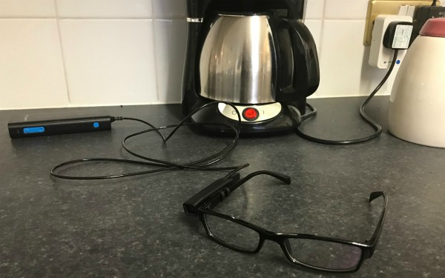
Camera
Cameras are now being used to promote independent living.
The Orcam MyEye is a different device. Mounting onto the frame of a pair of glasses, it can assist people with visual impairments by reading text, recognising faces and identifying objects. The information is relayed to the wearer via a small earpiece microphone.
The Ring smart video doorbell enables front doors to be answered remotely via friends’ or relatives’ smartphones, which display images of who is standing in the doorway.

Slide 23
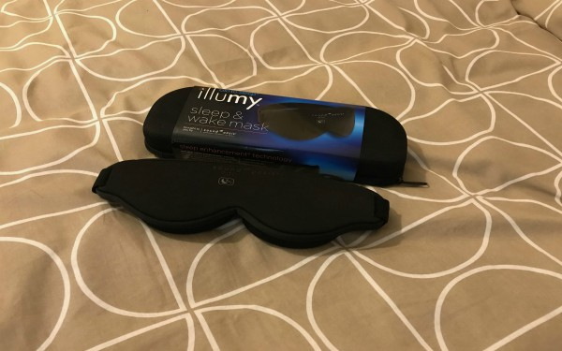
Sleeping
Several devices are geared around promoting restful sleep which people with learning disabilities, autism, dementia and a range of mental health problems are less likely to experience.
The Illumy sleep mask uses pulsing red-toned light to help wearers become calm and fall asleep and blue tones to assist with waking up. In an adjacent bedroom the Zeeq smart pillow conceals a range of functions including a vibration alarm to encourage movement when snoring is detected, and analysis of sleep quality, which is sent to a smartphone app.

Slide 24
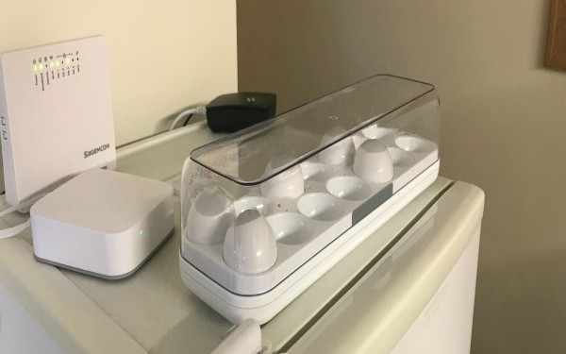
Eating and Drinking
In the kitchen there are a number of gadgets to help people maintain eating and drinking habits. The HAPIfork monitors the speed and duration at which meals are eaten, with indicator lights and gentle vibrations alerts if you’re eating too fast.
The Smarter iKettle, meanwhile, is controlled by a smartphone and can have water boiling by the time someone enters their kitchen, meaning people do not have to stand for as long when making a hot drink.
The Quirky Egg Minder, as its name suggests, keeps tabs on eggs and sends notifications to prevent bad ones being eaten.

Slide 25
Sensors
Motion detectors have been used for more than a decade so people can keep a person safe. Now, a much more sophisticated array of sensors, which send data to backend applications and communicate with mobile devices, can build detailed pictures of people’s lives to help with care planning.
We know, if someone has everything in, about temperature, light levels, if they sleep in the living room, when they sit on the sofa, if someone comes to visit them and whether the front door is opened at night.
By writing ‘rules’ based on the information the sensors give out, alerts can also be triggered when something goes awry.
For example - a woman who fell in her bathroom soon after her carers had left; because sensors recognised that she had entered the room but not left, social care staff were notified within 45 minutes.

Slide 26
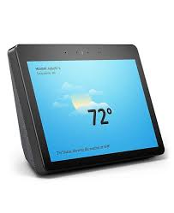
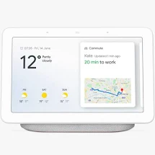
Voice Activated Assistants
Amazon’s Echo smart speaker, with its digital assistant Alexa, has been being trialed by some councils over the past couple of years. Google’s Home, a competing voice-activated device, was also trialed, though for the moment its usefulness lags slightly behind.
The digital assistants can help people with reduced mobility or cognitive impairments by enabling voice control of things light lighting, heating and curtains opening or closing, as well as providing reminders, for instance around medication. The Echo, which in its latest ‘Show’ iteration adds a video screen, has also been adapted to facilitate carers checking in and out of people’s homes, and to enable residents to summon help by voice command alone.

Slide 27
What next……….
Keep it simple!
Training for Staff – this could be basic computer training, we need to take the workforce with us on the journey
Funding – capital investment, more investment is needed if we are to start working on more complex and integrated solutions
Collaborative approach – stop silo mentality – we need our partners to work with us on an aligned strategy, partners been NHS, but also Local Authorities
Educate providers – technology is good, lets not be scared

Slide 28
8 Recommendations
Explore the feasibility of creating a single online information resource about digital technologies in social care, focused on the strategic planning and management of digital technologies in the social care context
Consider providing guidance for employers in the sector on digital data and system security issues.
Consider providing a framework for discussion on ‘bring your own device` approaches, to enable social care employers to take informed strategic decisions about their policy on personal digital devices.
Review relevant digital skills and competency frameworks with a view to their potential use across the adult social care workforce in England.

Slide 29
8 Recommendations
5. Consider the need to develop a learning and support programme for strategic digital skills in social care.
6. Consider developing a national social care ‘digital champions’ support programme; review approaches currently being used in the housing sector with a view to replicating it for the social care sector.
7. Consider making core information and communication technologies (ICT’s) skills a mandatory part of all learning and development and qualifications frameworks.
8. Make explicit mention of digital skills and skills assessments in the revision of the recruitment and retention strategy for adult social care currently being undertaken by Skills for Care.

