Slide 1
The European Knowledge Tree Group (EKTG) with AAL
Responsible AI – where is the client in the data?
By Dr. Henk Herman Nap (Vilans)
Email : h.nap@vilans.nl
& Dirk Lukkien (Vilans) – d.lukkien@vilans.nl
Workshop 1 24th September, 2019, AAL Forum, Aarhus, Denmark

Slide 2

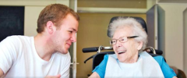
Vilans
Our mission
In co-creation with the field of long-term care, we develop, disseminate and implement innovative and applied knowledge.
To ensure efficient, cost-effective and high quality long-term care and to enhance the quality of life of people who need care and support.
Independent
Co-creation
Knowledge
Hybrid financing
Not for profit
Notes:
Well, a small introduction about the organization I work for. Vilans is the expertise centre on long-term care in The Netherlands. We develop, implement and disseminate innovative and applied knowledge to care professionals, consumers / end-users, policy makers, but also industry and education. We are an independent organization with almost 170 employees with an academic research team of almost 40 researchers of which 10 a PhD. We always work in co-creation with the field, iterative, from start till end.

Slide 3
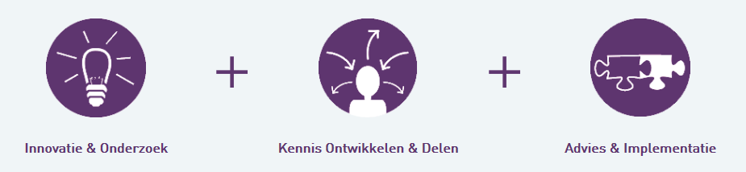
Professions / Teams
Advise & Implementation (advisors)
Research & Innovation (researchers)
Marketing & Communication (dissemination)
Teams/Themes, e.g., Personalized Healthcare, Integrated Care, Community Care, Quality, Online Learning, eHealth…

Slide 4

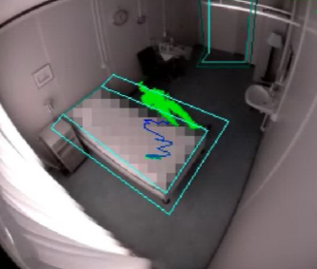
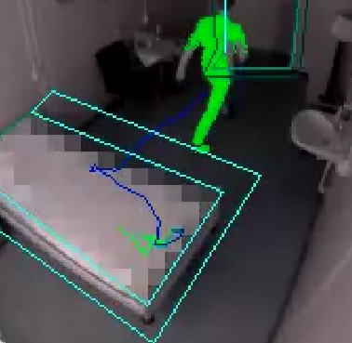
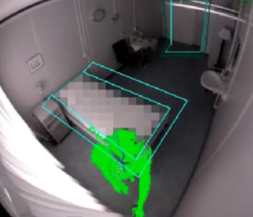
From alarms to meaning
  Trend….
  Pro-active
  Need for local expertise
  ‘Training’ care professionals (Task!)
  -> feeding the data correctly
  New professional

Slide 5
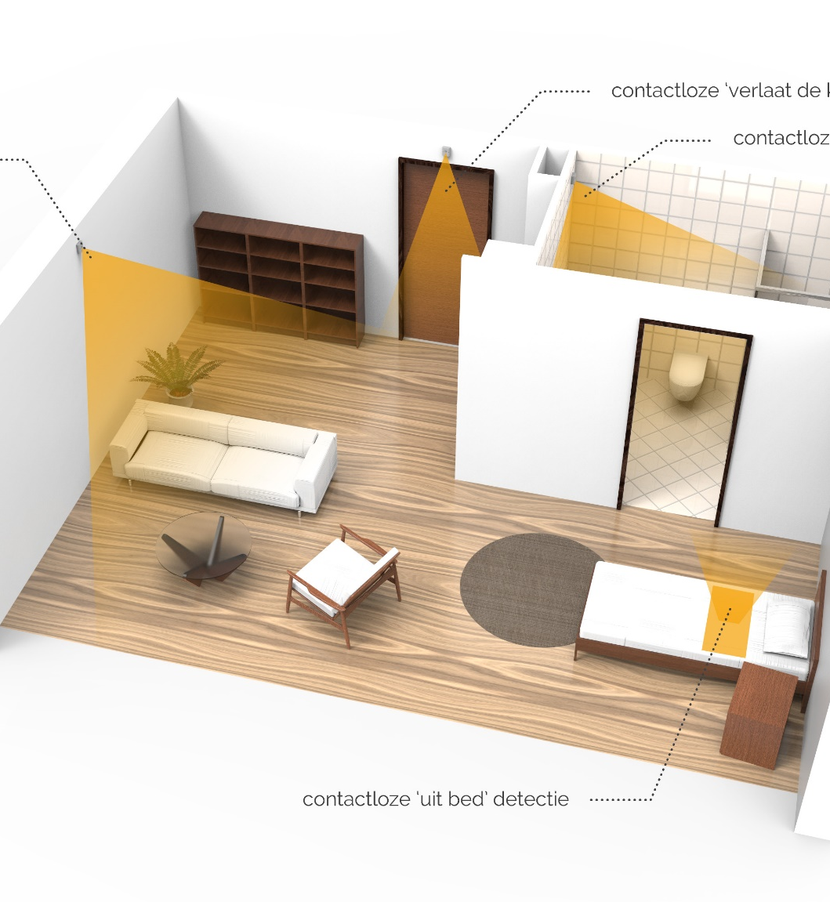
Co-creation of data
  Objective & subjective data
  Confirmation by end-users on data (objective data is valuable, but what does the client say or feel?)
  Annotation of data (e.g. is stress really stress?)

Slide 6
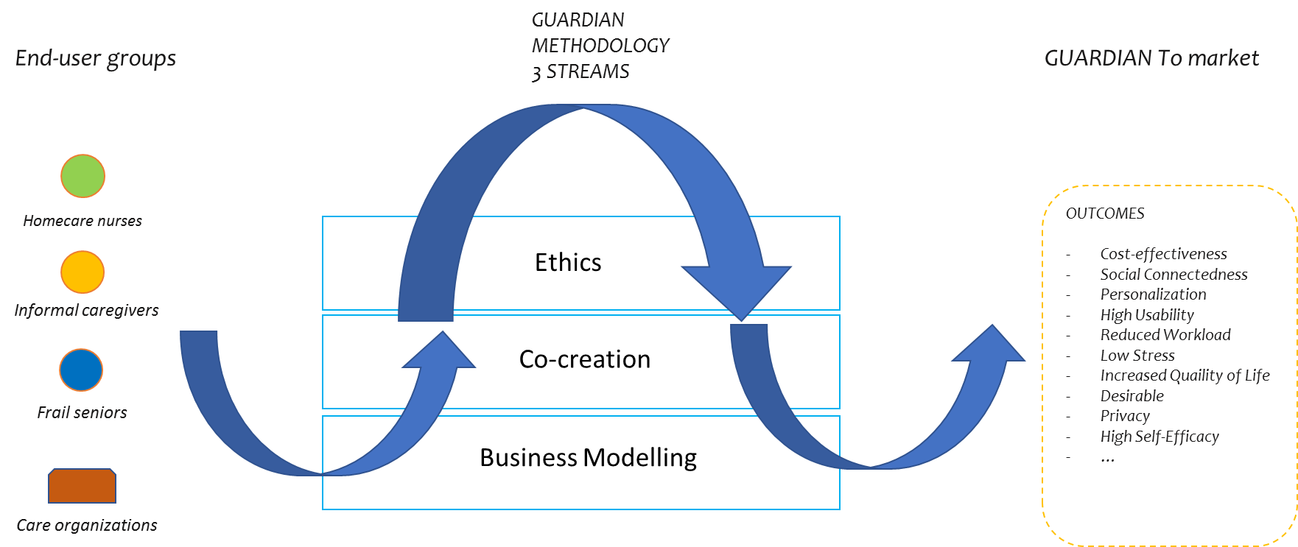
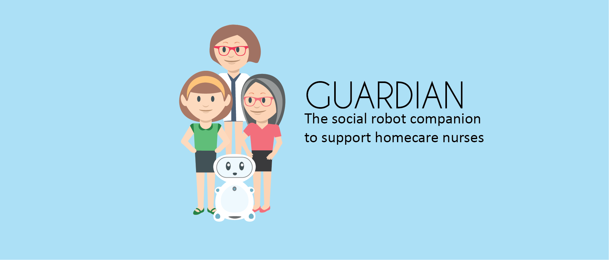
Ethical considerations from early design to local use

Slide 7

www.vilans.nl
h.nap@vilans.nl

