Slide 1


Your Partner for eHealth
longer better life

Slide 2
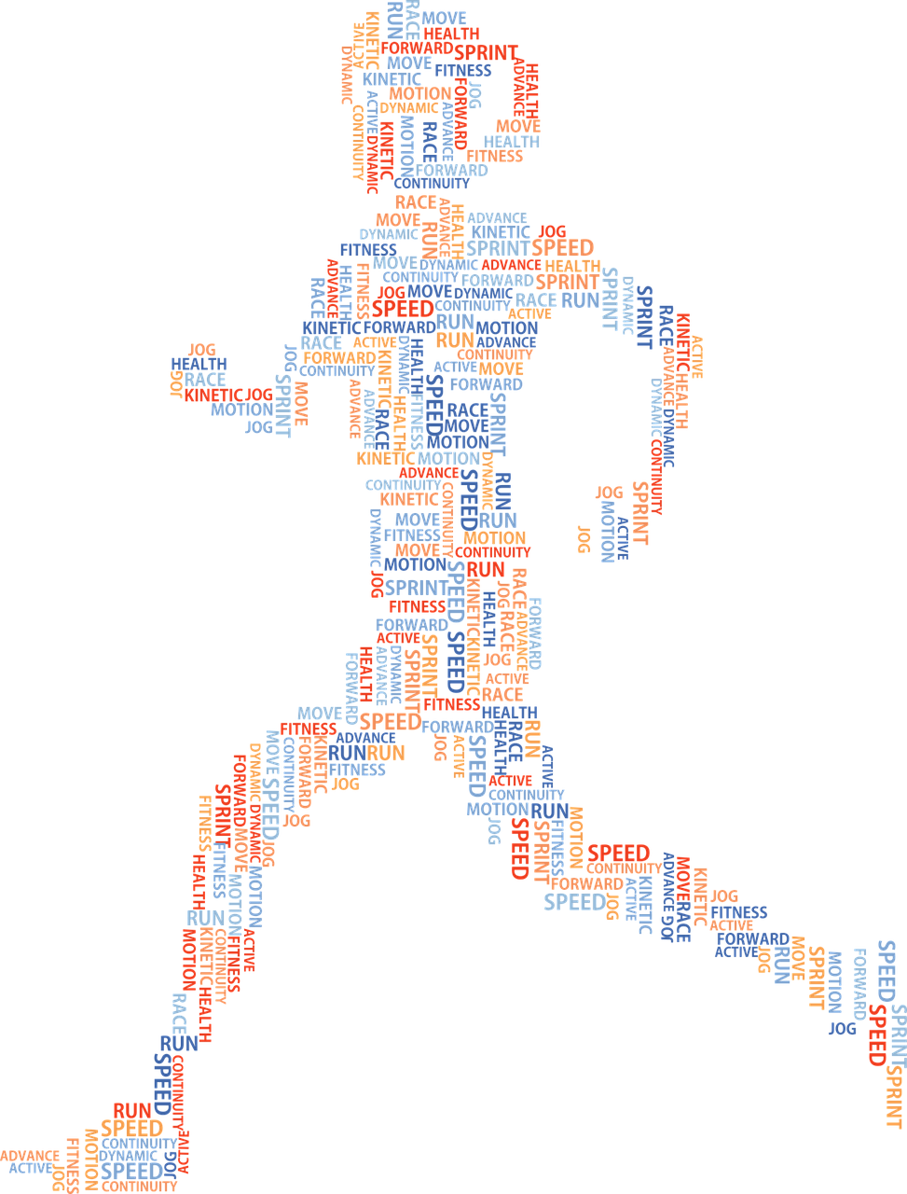
Challenges & Trends
Demographic change
Rising costs
Self-access
Lack of medical personnel
Cybersecurity
Health literacy
Patient empowerment
New technologies
People want to live as long as possible in their own homes

Slide 3
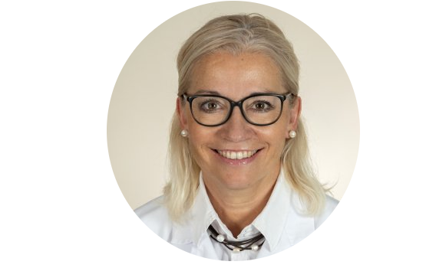
Prof. Dr. med. Christiane Brockes
Specialist in cardiology, emergency medicine and internal medicine
Since 1998 conducting telemedical consultations
Head of the Clinical Telemedicine at the University Hospital Zurich (2005 – 2008)
More than 55’000 medical online consultations
Book series: Health by mouse click
Lecturer at the University of Zurich "Clinical Telemedicine/eHealth"
Founder and CEO of alcare AG
International Ambassador of the European Knowledge Tree Group

Slide 4
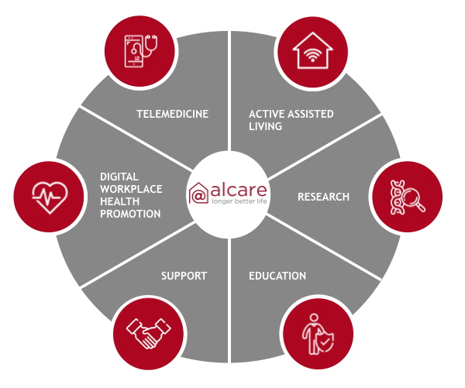
Your Partner for eHealth
More autonomy
More health
More life-quality
eHealth for:
Seniors facilities
Hospitals & medical practices
Municipalities
Enterprises

Slide 5
Senior citizens' facilities
Our approach
Workshop «Perspectives of Active Assisted Living»
Needs assessment and strategy development
Selection process for suitable AAL technologies and services
Implementation and education of the medical professionals and end users
Evaluation of selected digital solutions
Advantages
More health, safety and autonomy for tenants
Reducing the burden on care staff
Optimisation of support processes
Contemporary service offerings

Slide 6
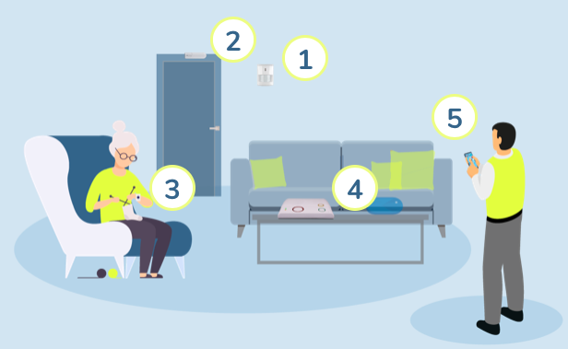
Project «Thurvita»
Thurvita is a non-profit organisation owned by the municipalities of Wil, Niederhelfenschwil, Rickenbach and Wilen in Switzerland. The main objective is to provide help and services for people in old age.
Example of an AAL solution from Easierlife:
Movement sensor
Door sensor
Emergency button
Base station
Alert

